Slide 1


The Fitness Place
logo
SUMMER CODING CAMP

Slide 2
My job is to help other people to start to like exsirsise and working out.
SUMMER CODING CAMP

Slide 3
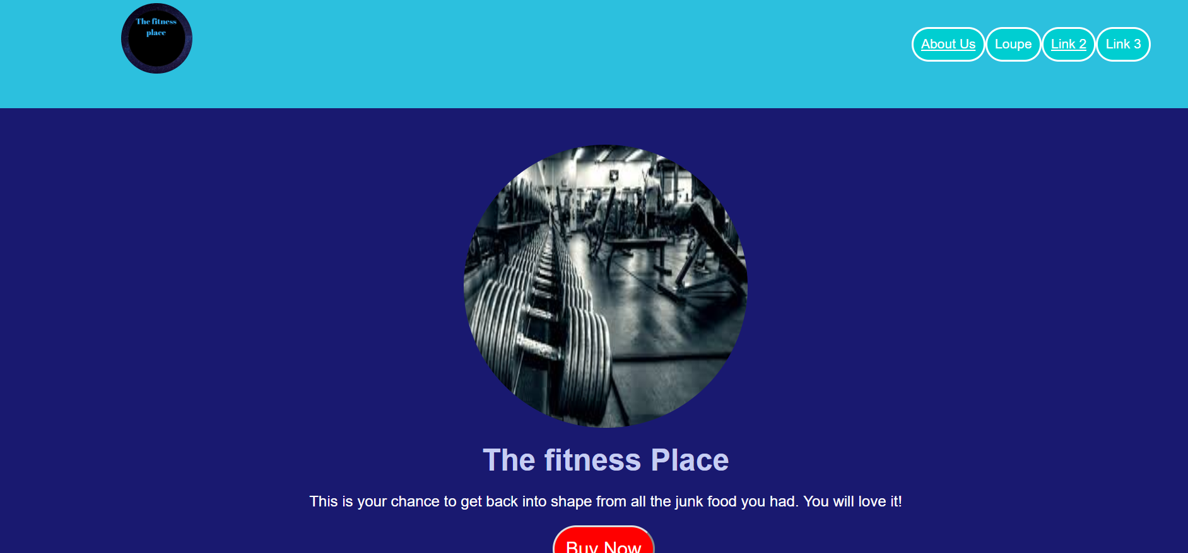
Screenshot of website
SUMMER CODING CAMP

Slide 4
THANK YOU!
SUMMER CODING CAMP

